Slide 1
Vaccine Passport
JLL

Slide 2

Use Case
Scan vaccine card
Extract Logo to validate CDC
Extract Details
Name
Provider Details
Vaccine model name, Serial No, and dates
Validate employee details
Use custom vision to detect CDC logo
KPI – display

Slide 3
KPI
How many folks vaccinated
How many didn’t
Which location

Slide 4
Architecture
End to End Flow
Form Recognizer for Covid vaccine information
Custom vision to validate CDC logo
Communication Service to send out alerts if unable to predict
Human process to manually validate failed ones
Use Mobile to upload vaccine photos to storage

Slide 5
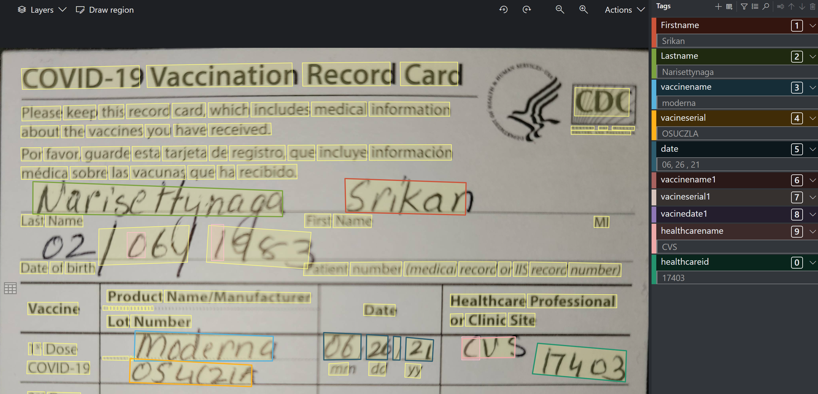
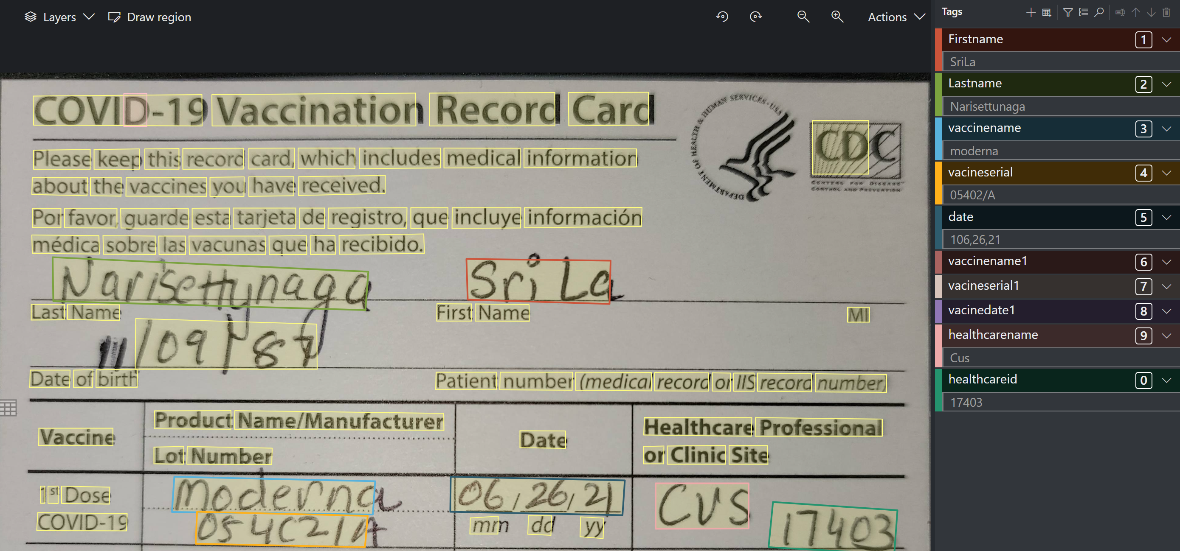
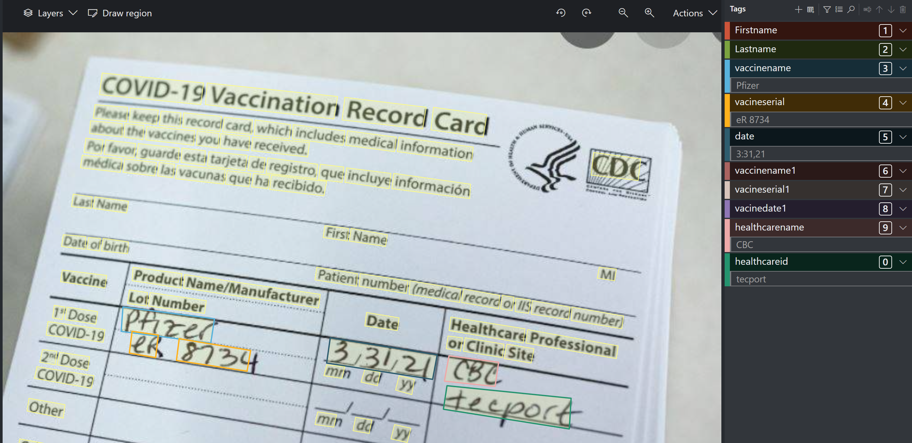
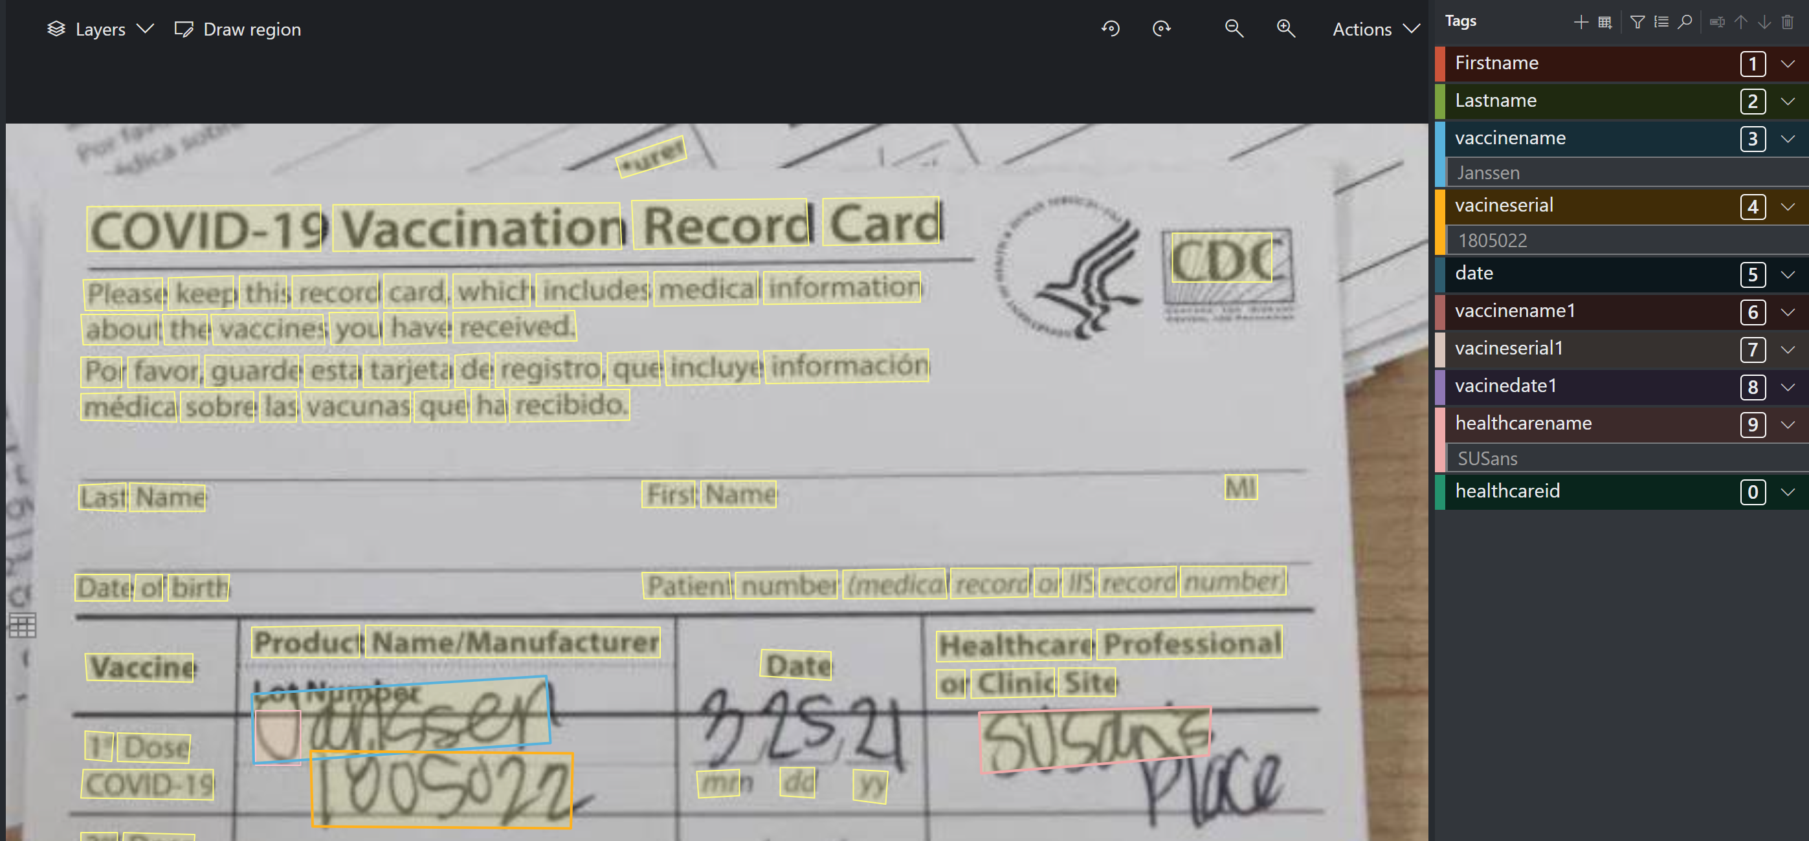
Form Recognizer Model

Slide 6
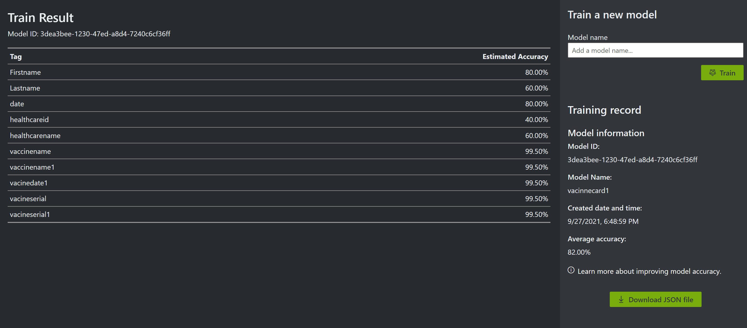
Training

Slide 7
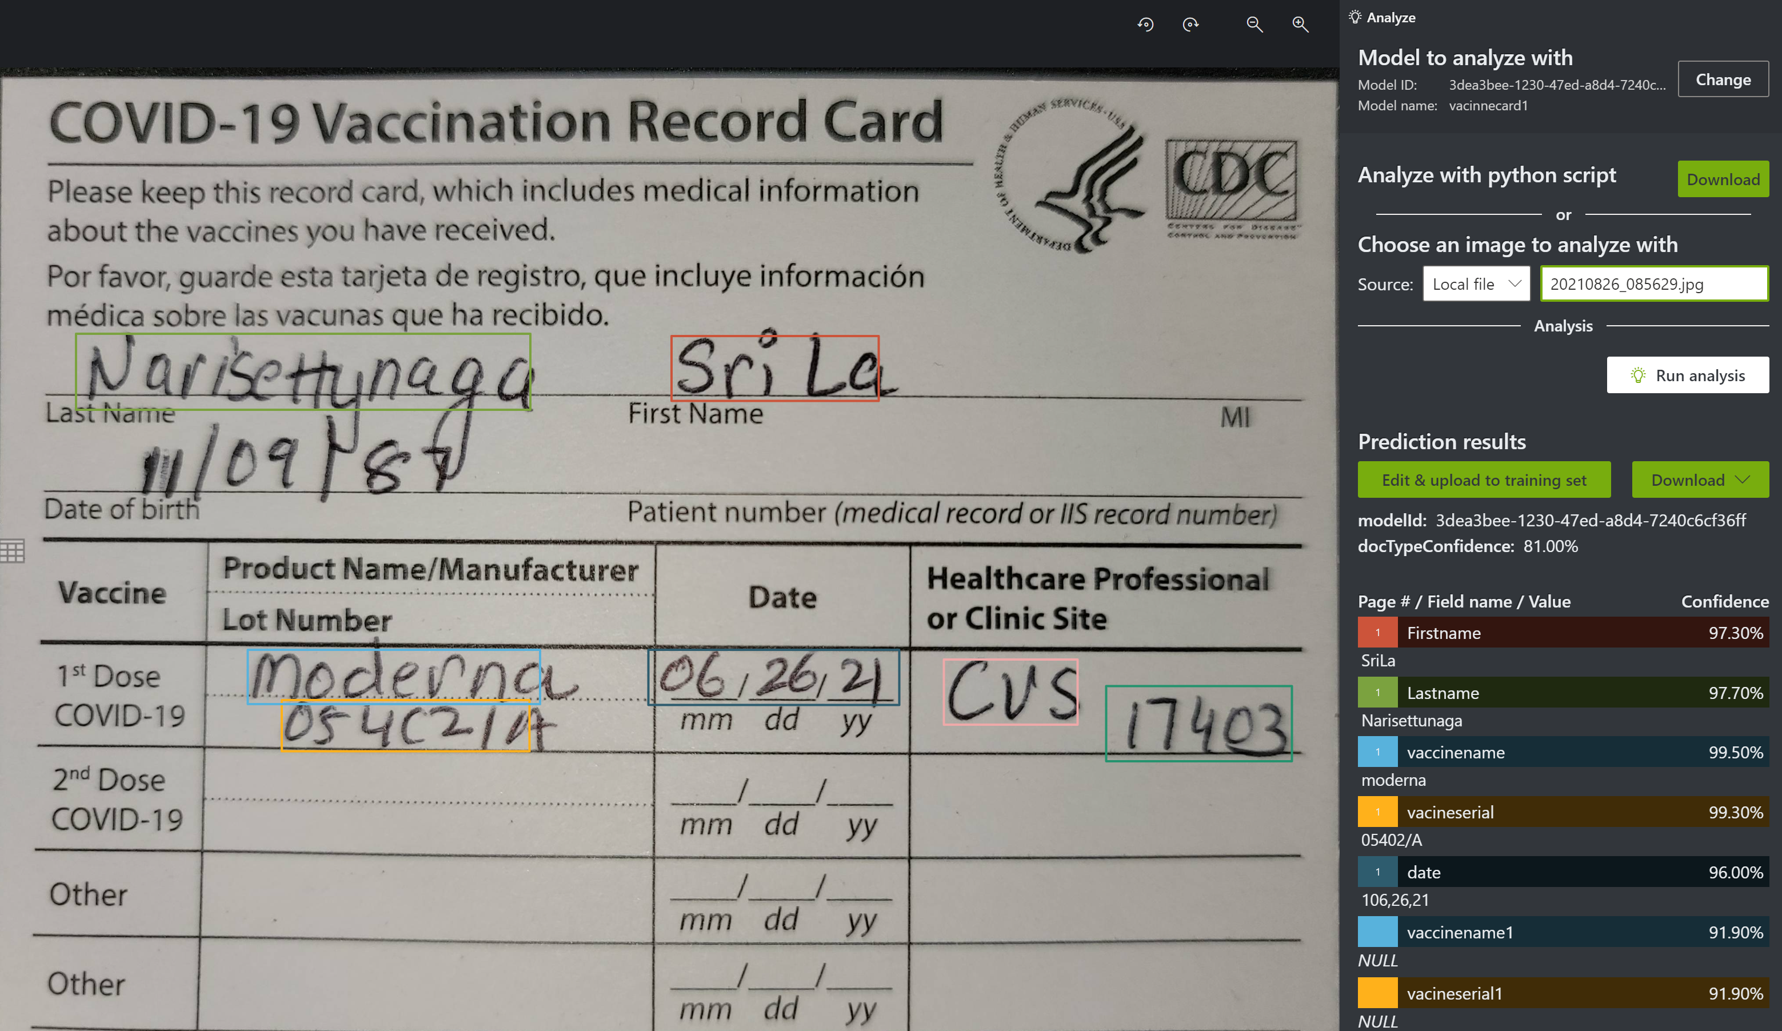
Test the model - Output

Slide 8
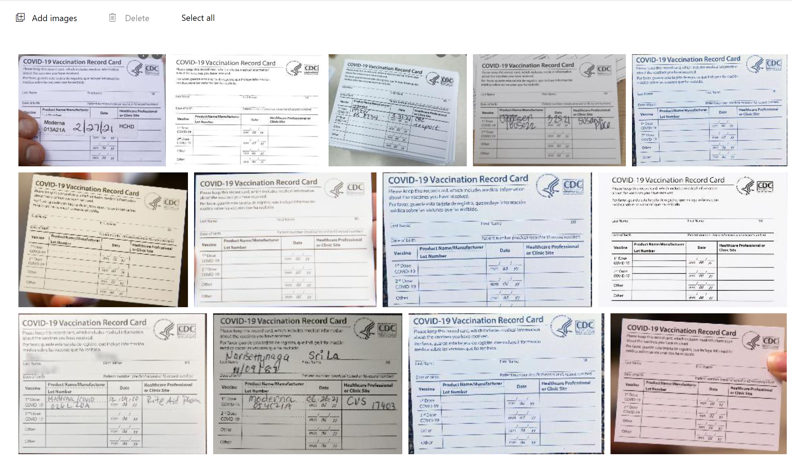
Images

Slide 9
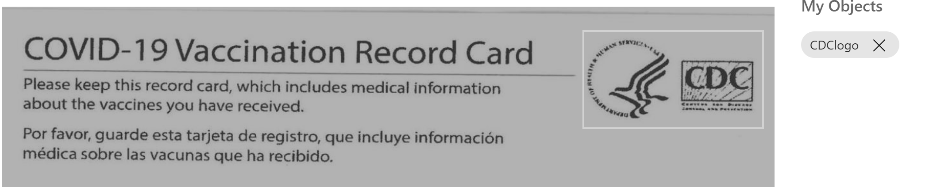
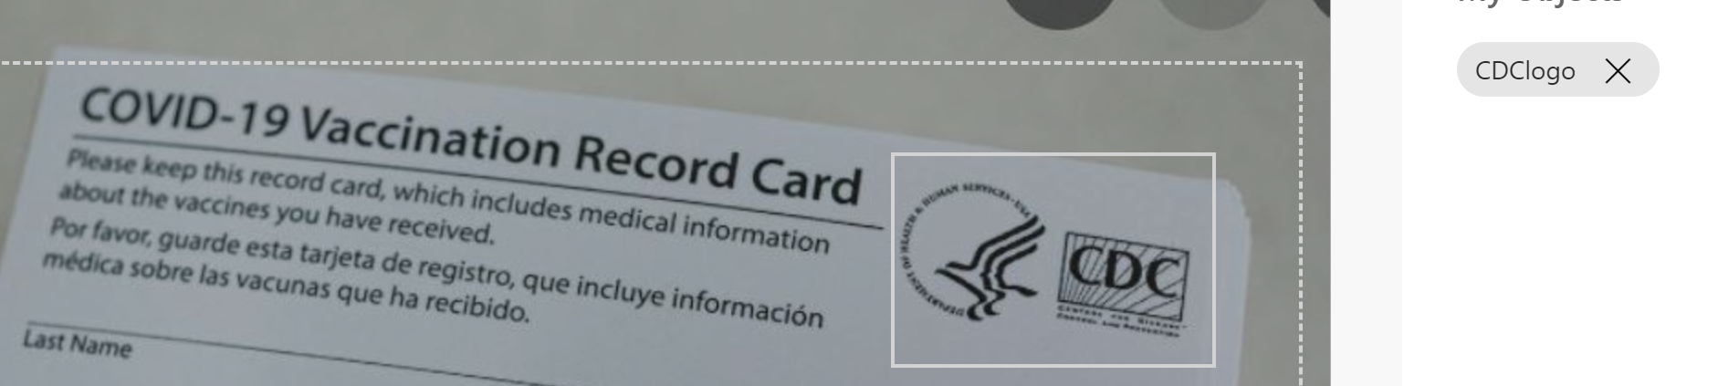
Training

Slide 10
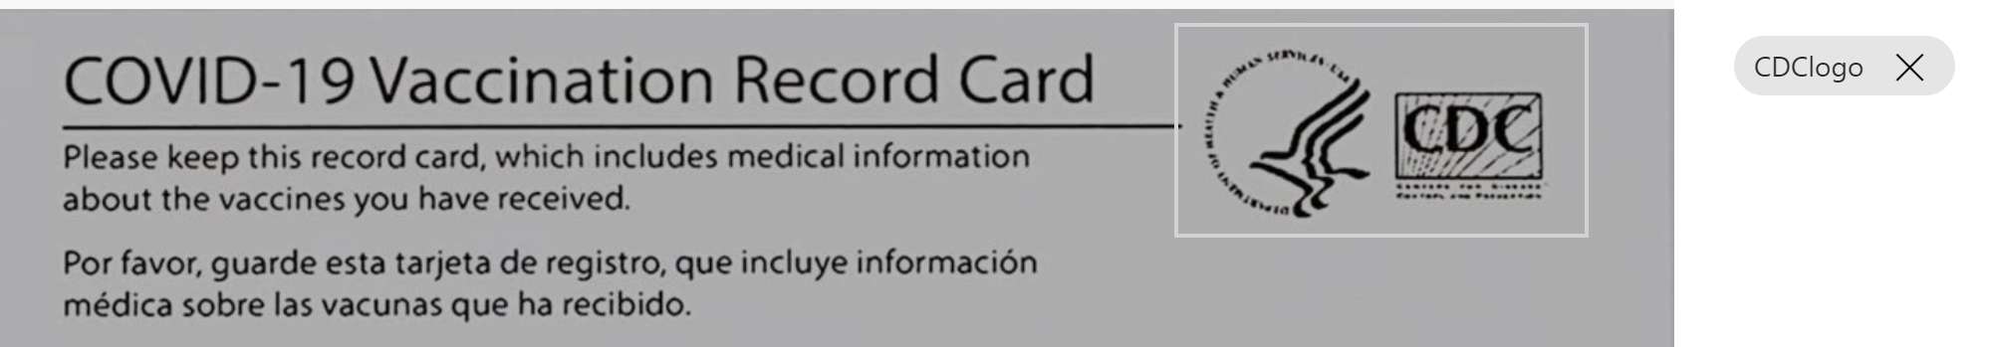
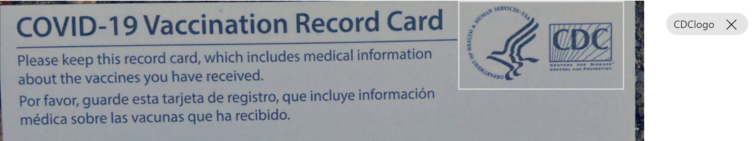

Slide 11
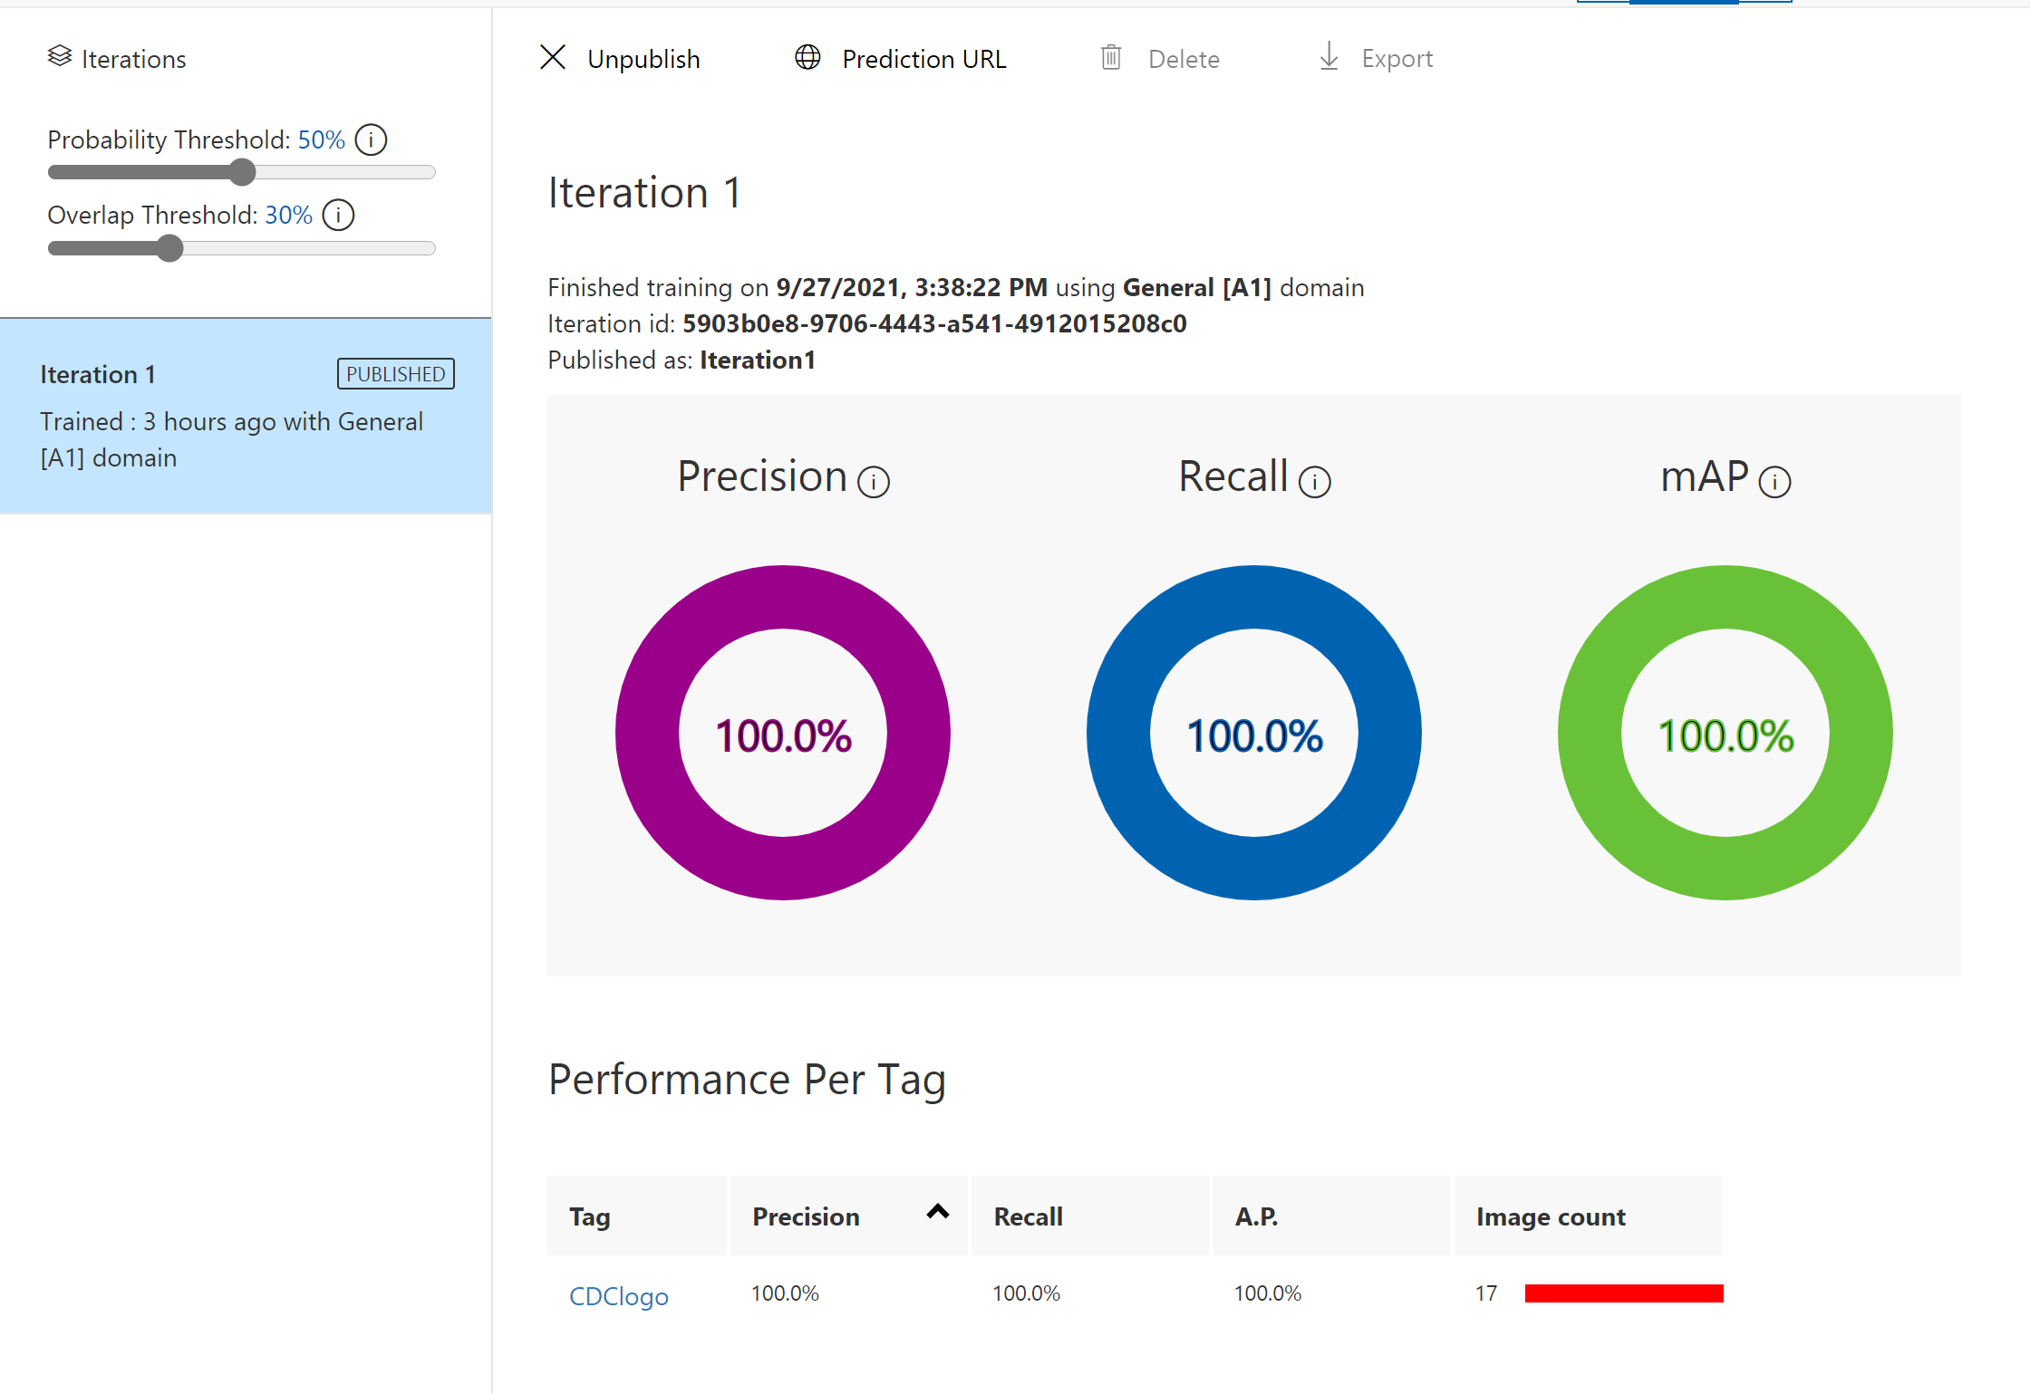
Model Performance

Slide 12
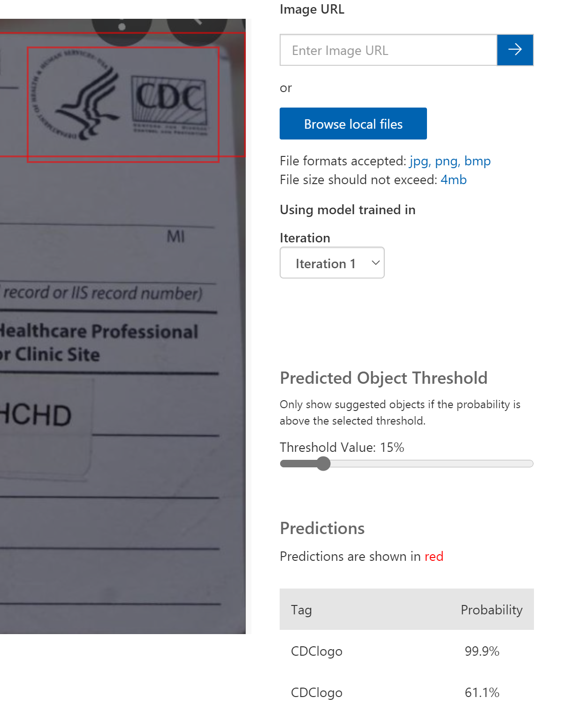
Quick Test

Slide 13
Custom Vision Prediction Code
from azure.cognitiveservices.vision.customvision.training import CustomVisionTrainingClient
from azure.cognitiveservices.vision.customvision.prediction import CustomVisionPredictionClient
from azure.cognitiveservices.vision.customvision.training.models import ImageFileCreateBatch, ImageFileCreateEntry, Region
from msrest.authentication import ApiKeyCredentials
import os, time, uuid
# Replace with valid values
ENDPOINT = "https://formreconame.cognitiveservices.azure.com/"
training_key = “training key"
prediction_key = “prediction key"
prediction_resource_id = “project id"
# base_image_location = os.path.join (os.path.dirname(__file__), "Images")
base_image_location = "C:\Code\CustomVisionAI"
# Now there is a trained endpoint that can be used to make a prediction
prediction_credentials = ApiKeyCredentials(in_headers={"Prediction-key": prediction_key})
predictor = CustomVisionPredictionClient(ENDPOINT, prediction_credentials)
with open(os.path.join (base_image_location, "blank14.jpg"), "rb") as image_contents:
results = predictor.detect_image(
“project id", "Iteration1", image_contents.read())
# Display the results.
for prediction in results.predictions:
print("\t" + prediction.tag_name +
": {0:.2f}%".format(prediction.probability * 100))

Slide 14
Logic App to create flow
First get Blob image SAS key
Send that to Form recognizer to analyse
Wait for few seconds
Send the Operation-Location back to get Analyzed Results
Save to blob as json
Send to custom vision for logo detection
Save the output as json in blob

Slide 15
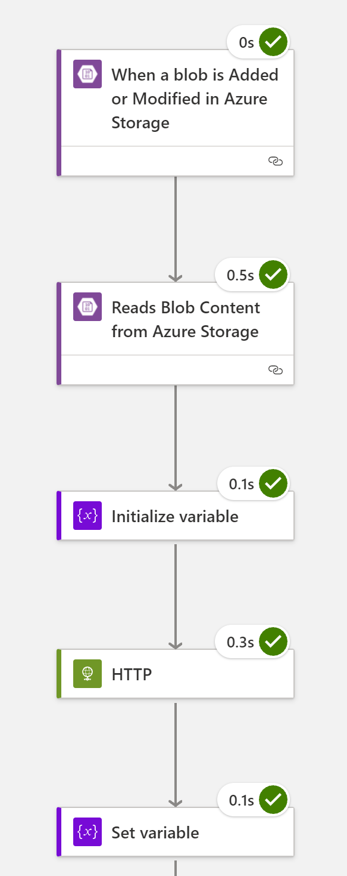
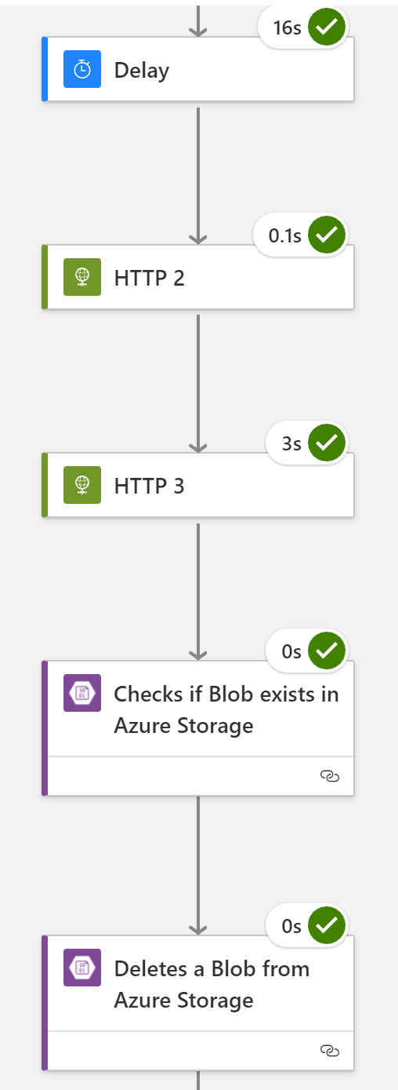
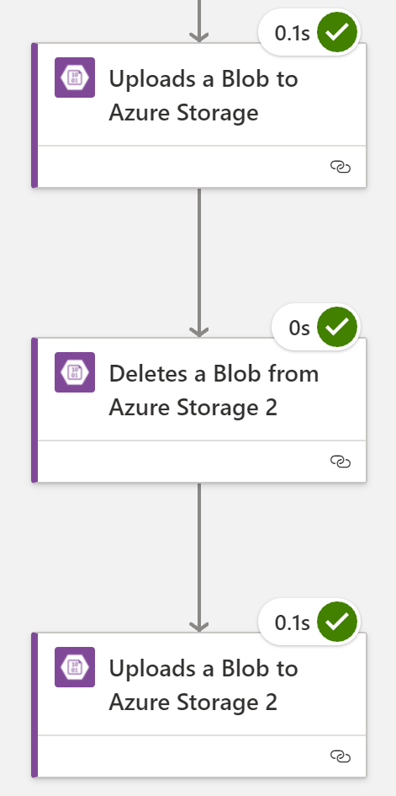

Slide 16
Logic App Flow explained
Trigger with Blob upload
Read the Image contents
Initialize a variable for Form Recognizer result URL
Call Form Recognizer (HTTP) Custom model Analyze
Save the Operation-Location URL in the variable
Wait for 15 seconds
Call Form Recognizer (HTTP) Custom Model AnalyzeResult
Save the output to blob in json format
Now Call Custom Vision Prediction URL
Send Blob SAS key URL of image
Save the results in blob as json
From here we can do follow up activities to process the results

